Slide 1




Group 1
HEARTSOAR
TOWER

Slide 2

INTRODUCTION

Slide 3
﻿Agenda
1
Game Story
2
Highlights
3
Challenges & Lessons
4
Demo
5
Future iterations

Slide 4


Heartsoar Tower
Welcome, Harmony, to the enchanted world of Terra Motus...
Story:
The King and Queen of Terra Motus are grief-stricken. An evil curse has sealed away their young Prince Timore in a tower at the edge of their kingdom.
The royalty have requested you, Harmony, to enter the tower and save their gentle son.
Objective:
Your mission is to navigate through the tower, overcoming challenges along the way.
To win, you must free Prince Timore from the curse by reaching the top of the tower.
Are you ready to begin your journey, Harmony? The fate of Prince Timore rests in your hands!

Slide 5
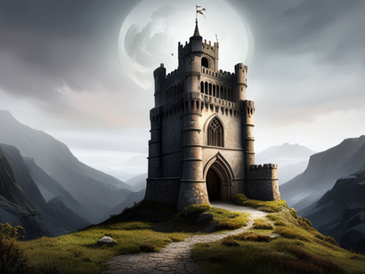


Highlights
01
02
03
04
Visual Storytelling
Suprise twist ending
Character Progression
NPC interaction

Slide 6
Overcoming Challenges
Being a man down
Buggy code
Working singleton factory full of statics
Learning Java Swing
Managing scope and work load.
Code was difficult to refactor and debug
Translating many static methods to a gui
Being new to the world of graphical user interface

Slide 7

Challenge
Solutions
Man Down
Statics
Java Swing
Adjusted our user stories to reflect 2 team members. Committed small updates and worked through bugs.
Beginning blocker. We had to find a workaround by adjusting constructors and using the player class inside GuiBuild.java
Started watching tutorials and gained general knowledge. Hardest part was appending to J Object from inherited code.

Slide 8
More Challenges
Map functionality
Initial graphic updates
Technical Debt
Not modifying the code
Getting a map to update while the player moves around the game
Cannot access certain JSON from the GUI
Bugs or using AI creates more problems
Future updates we wanted to do but were constrained by sprint/user stories

Slide 9
Challenge
More Solutions
Map
Graphic Update
Technical Debt
Due to sprints, went the easy route and made separate maps for each location
Not able to load all the graphics but given another sprint, would have aided in finding a solution to obtaining graphics in JSON
Realized later that refactoring early on could help debugging. Also learning about watchpoints and conditionals.

Slide 10
Agile Lessons
01
Customer Collaboration:
Consistent updates
Gaining insight
Knowing when to pivot
02
Iterative Development:
Small, manageable "VALUABLE" increments
Team progress
Smaller sections to debug
03
Focus on Delivering Value:
Challenge
Knowing what's of value
(MVP) Minimum Viable Product
04
Embracing Agile Mindset:
Valuing collaboration
Flexibility
Continuous learning
MVP

Slide 11
DEMO

Slide 12
Future Improvements
01
More refactoring
02
Tileset Map
03
Debugging Console
04
2D game engine
05
Layout scaling
06
Clickable room items

Slide 13

Question and Answe﻿r...

Slide 14
Group 1
﻿THANK YOU

